Slide 1
Data Preprocessing

Slide 2

Data Preprocessing
Data preprocessing is the most important phase of a machine learning project.
"garbage in, garbage out“
Useless features, outliers, missing values , etc…

Slide 3
Why Data Preprocessing?
Data in the real world is dirty
noisy: containing errors or outliers
No quality data, no quality mining results!
Quality decisions must be based on quality data

Slide 4
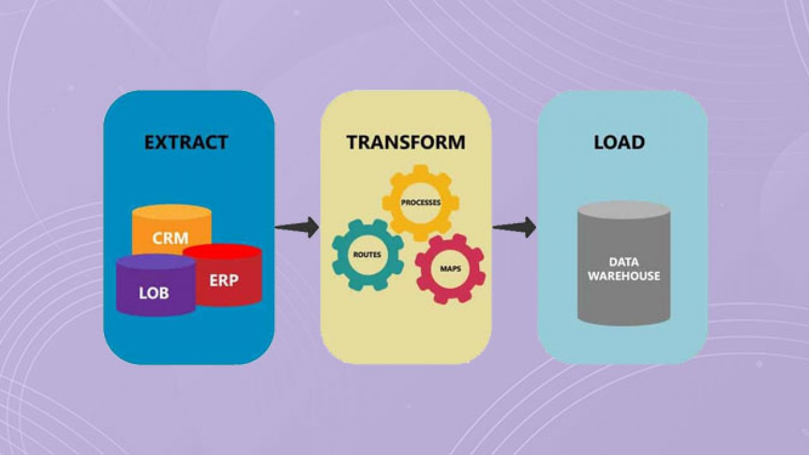
ETL
Feature Engineering and Extraction
Extract useful features from raw data into features suitable for modeling.
Transformation
Transformation of data to improve the accuracy of the algorithm.
Feature Selection
Removing unnecessary features.

Slide 5
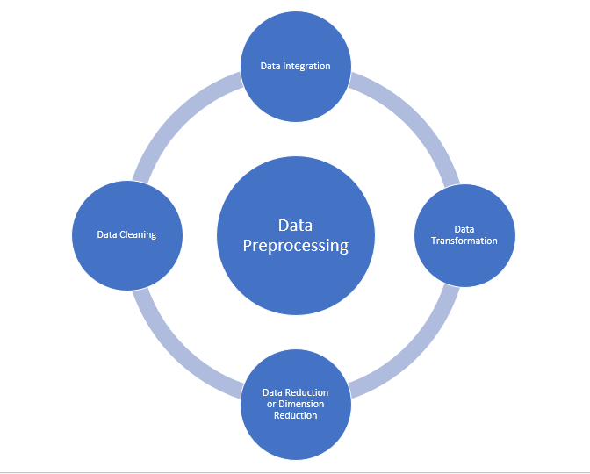
Major tasks of data preprocessing

Slide 6
Data cleaning
Fill in missing values
smooth noisy data
identify or remove outliers
Data integration
Integration of multiple databases, files, or notes.

Slide 7
Data transformation
Normalization (scaling to a specific range)
Data reduction
Obtains reduced representation in volume but produces the same or similar analytical results
Data discretization: with particular importance, especially for numerical data

Slide 8
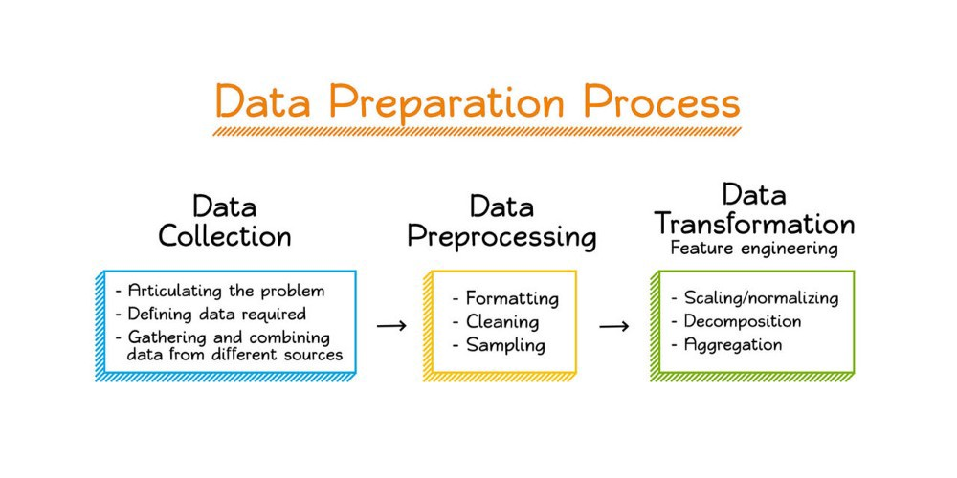

Slide 9
Data Cleaning - Missing Data
Types of missing data:
❑ Missing completely at random
❑ Missing at random
❑ Missing not at random
Causes of Missing data:
❑ Not applicable N/A
❑ Not available
❑ Unknown
❑ Refusal to answer
❑ True missing
❑ Error in signals

Slide 10
Data Cleaning - Missing Data
• Missing data Problems:
❑ missing data can introduce a
substantial amount of bias
❑ make the handling and analysis of the
data more arduous
❑ create reductions in efficiency.
• Imputation:
❑ is the process of replacing missing
data with substituted values.

Slide 11
Handling missing values
https://towardsdatascience.com/7-ways-to-handle-missing-values-in-machine-learning-1a6326adf79e

Slide 12
Data Cleaning – Categorical Data
• What is categorical data:
❑ categorical variable is a variable that can take on one of a limited, and usually fixed
• Example of categorical Data:
❑ The blood type of a person: A, B, AB or O.
❑ The state that a person lives in.

Slide 13
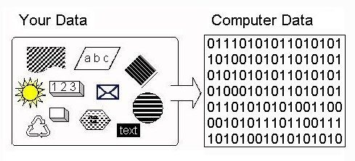
Data Cleaning – Categorical Data
• Encoding
It is the process of converting data from one form to another.
• Types of encoding:
Label Encoding
Fit & Transform
One-hot encoding

Slide 14
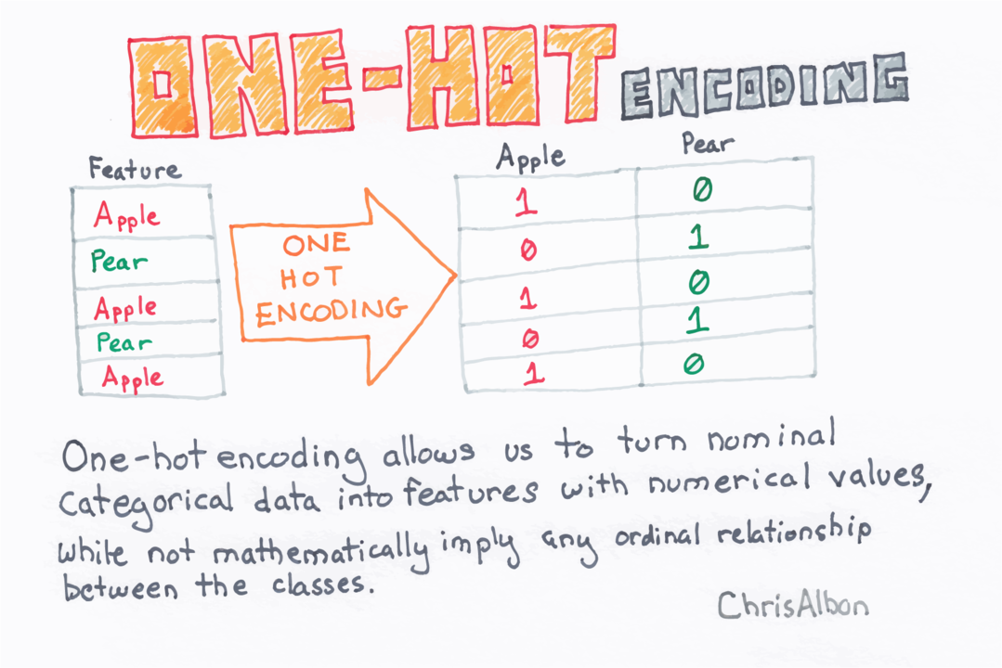
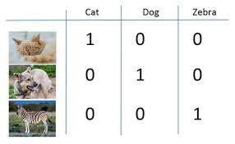
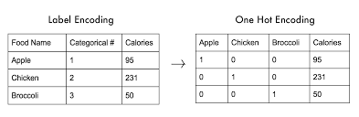

Slide 15
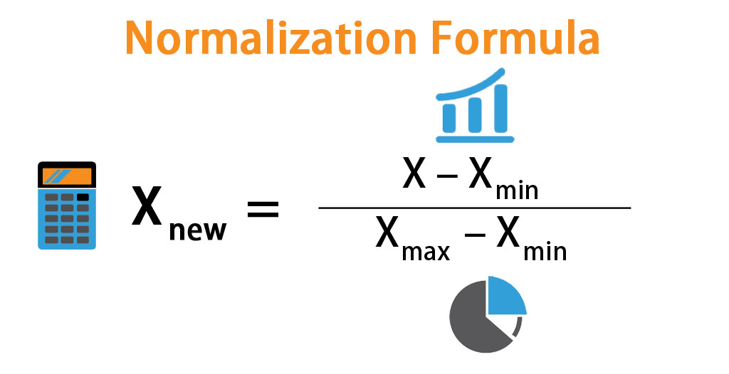
Data Transformation : Feature scaling
• Normalization
Normalization rescales the values into a range of [0,1].
This might be useful in some cases where all parameters need to have the same positive scale.
However, the outliers from the data set are lost.
(all positive)

Slide 16
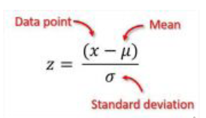
Data Transformation : Feature scaling
• Standardization
Standardization rescales data to have a mean (μ) of 0 and standard deviation (σ) of 1
(unit variance).
or most applications standardization is recommended.
(-3,3)

Slide 17
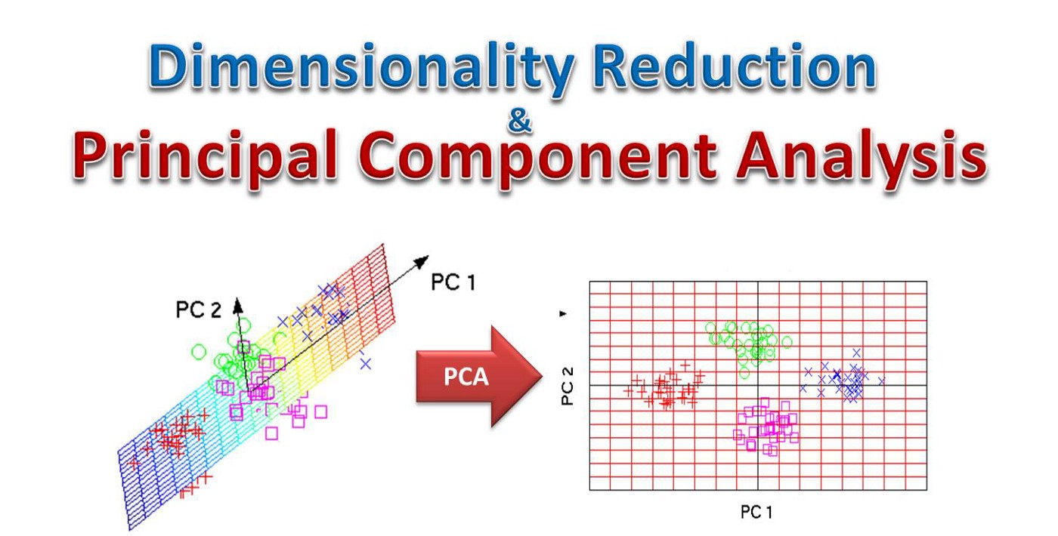

Slide 18
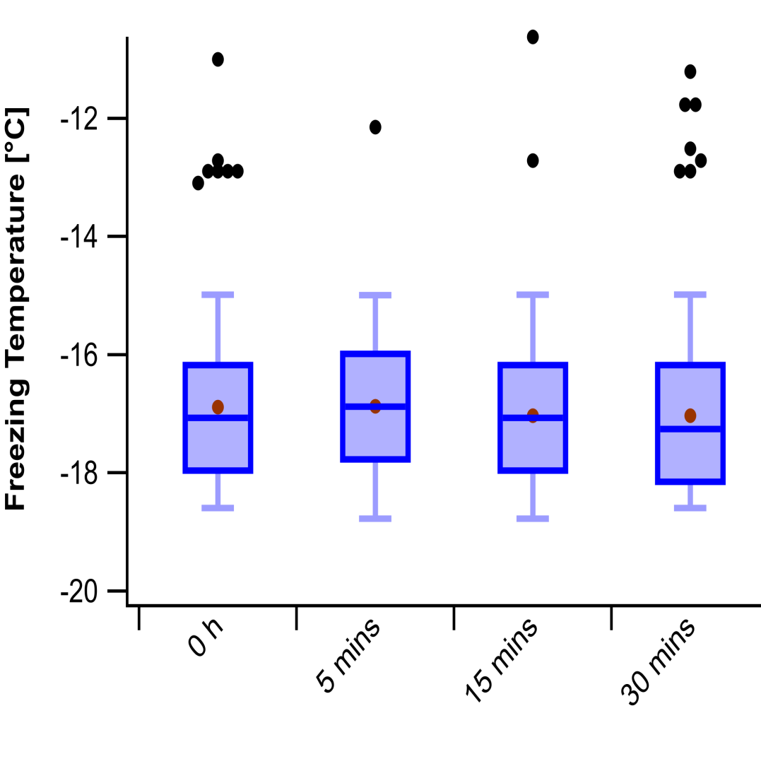
Detect and Handle Outliers
• Detect Outliers with Visualization.
Detect and Handle Outliers with Z- Score(Standarization).
• Detect and Handle Outliers with IQR.

Slide 19
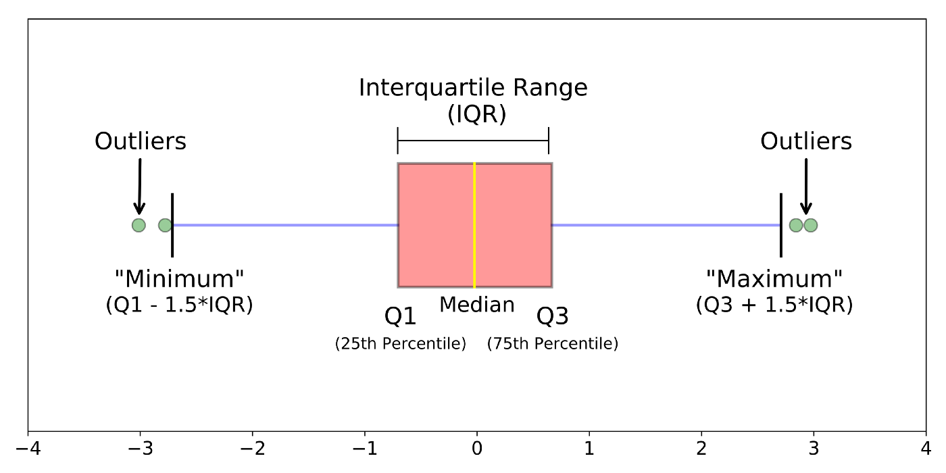

Slide 20
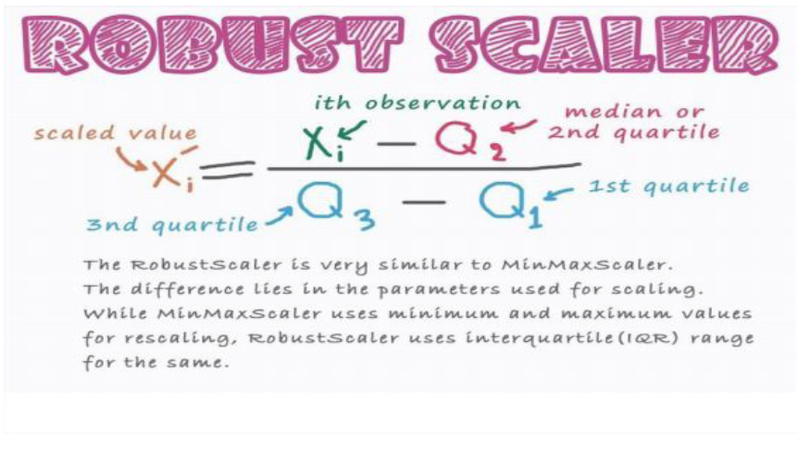
Robust scaling

